Slide 1
India’s Agricultural Crop Production Analysis(1997-2021)

Slide 2
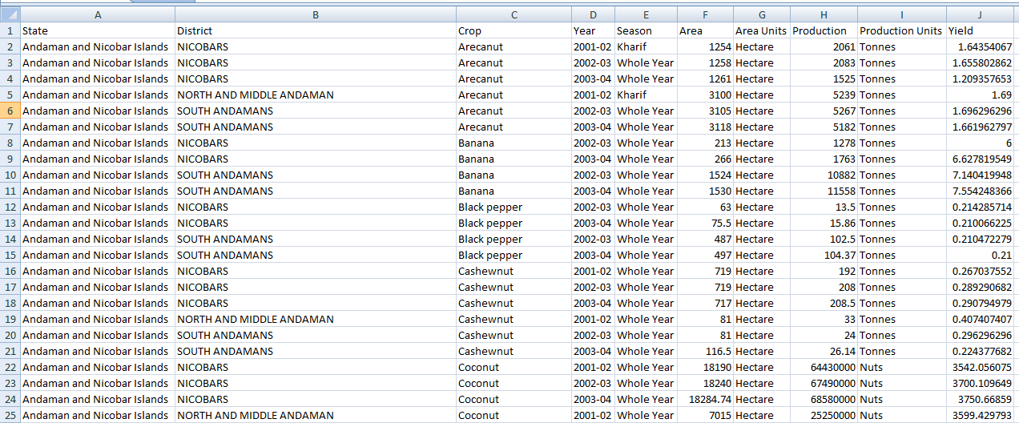
The provided dataset

Slide 3
India’s Agricultural Crop Production Analysis(1997-2021)
INTRODUCTION:
Overview
This project deals with region wise India’s agricultural data.
This work gives comprehensive visual exploration of key aspects and trends in agricultural sector.

Slide 4
Purpose
The purpose of this project is to visualize the data.
This agricultural data consists of 3,45,408 data which gives the information of different states and districts
The different attributes of this data such as year wise, season, crop variety, area, yield are given in the data source.

Slide 5
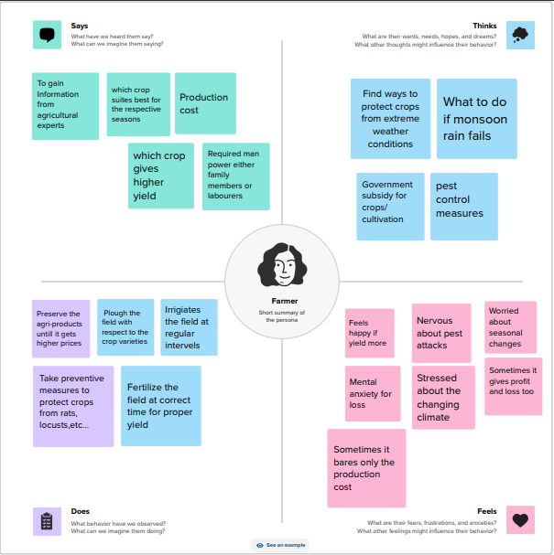
EMPATHY MAP
An empathy map is a tool used in design thinking to build an emotional representation of a user or a customer.
This is the empathy map of the given data.

Slide 6
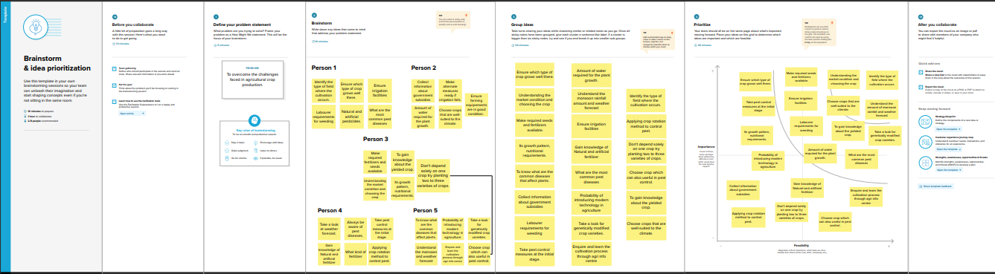
BRAINSTORMING
Next, we have created a brainstorming map
This is the brainstorming map of this project.

Slide 7
We have created 8 charts from the agricultural data.
Now we will see the charts one by one.

Slide 8
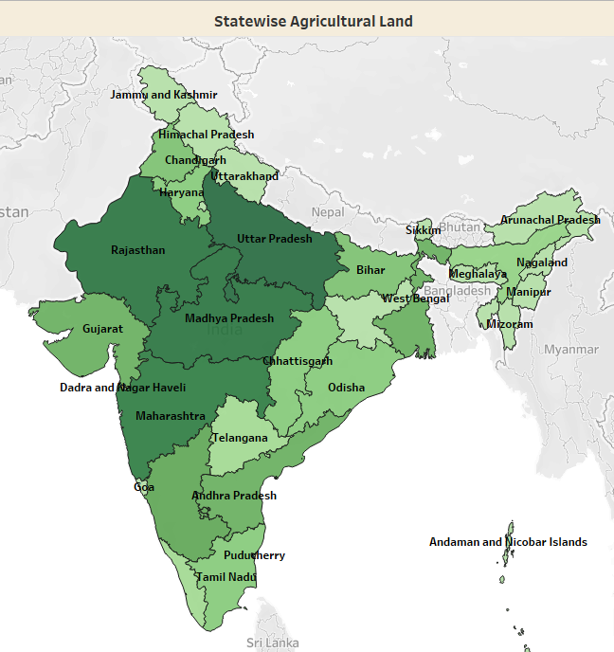
Indian map
This is the first sheet, which deals with the state wise agricultural land details.
Visualizing area comprising by states of India for easy comparison and exploration.

Slide 9
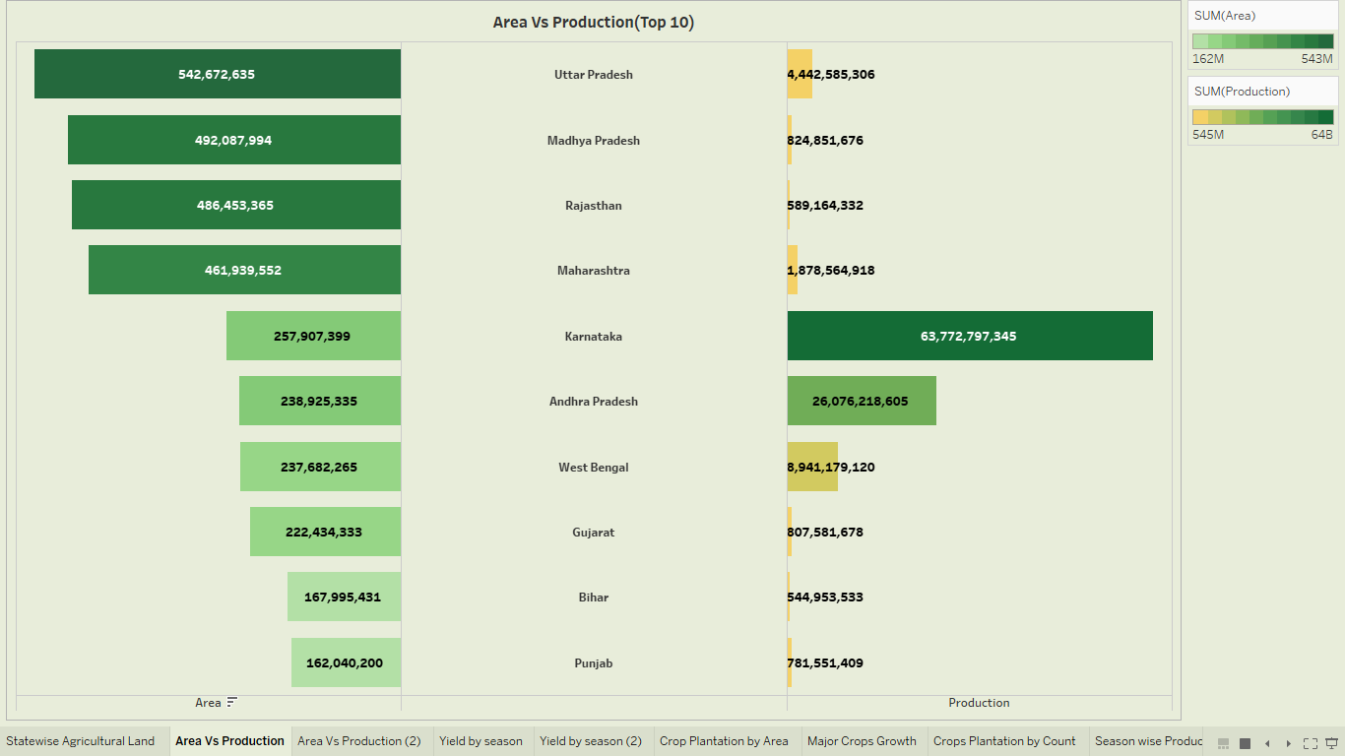
Butterfly chart
Area vs. production:
Top ten states- This butterfly chart offers a visual comparison of area and production

Slide 10
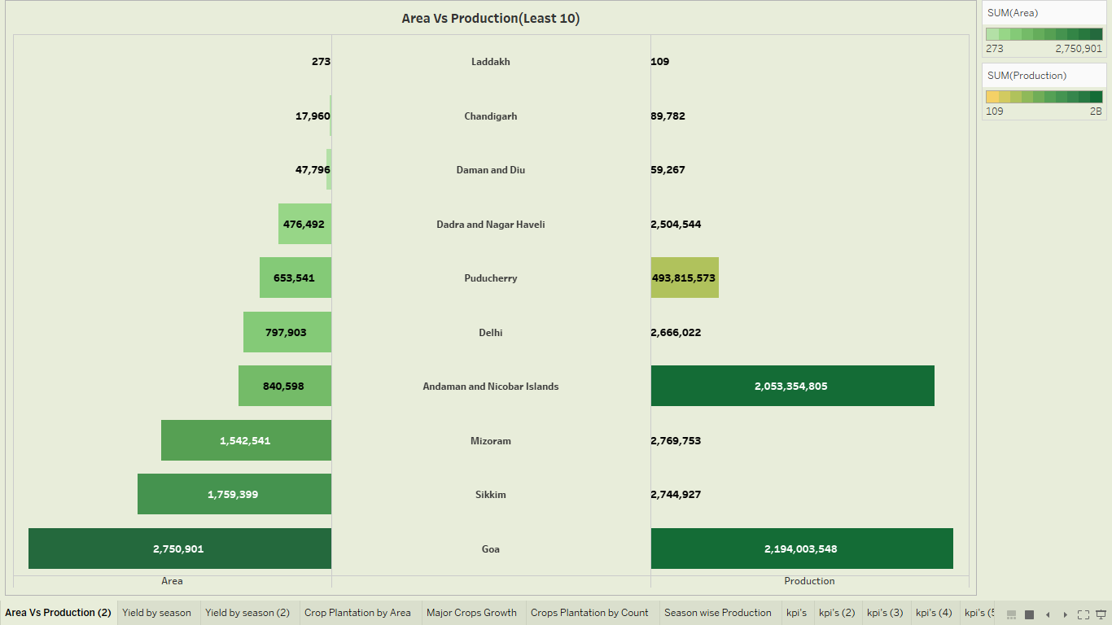
Butterfly chart 2
Area vs. Production:
Last ten states- This butterfly chart offers a visual comparison of production in states of less area

Slide 11
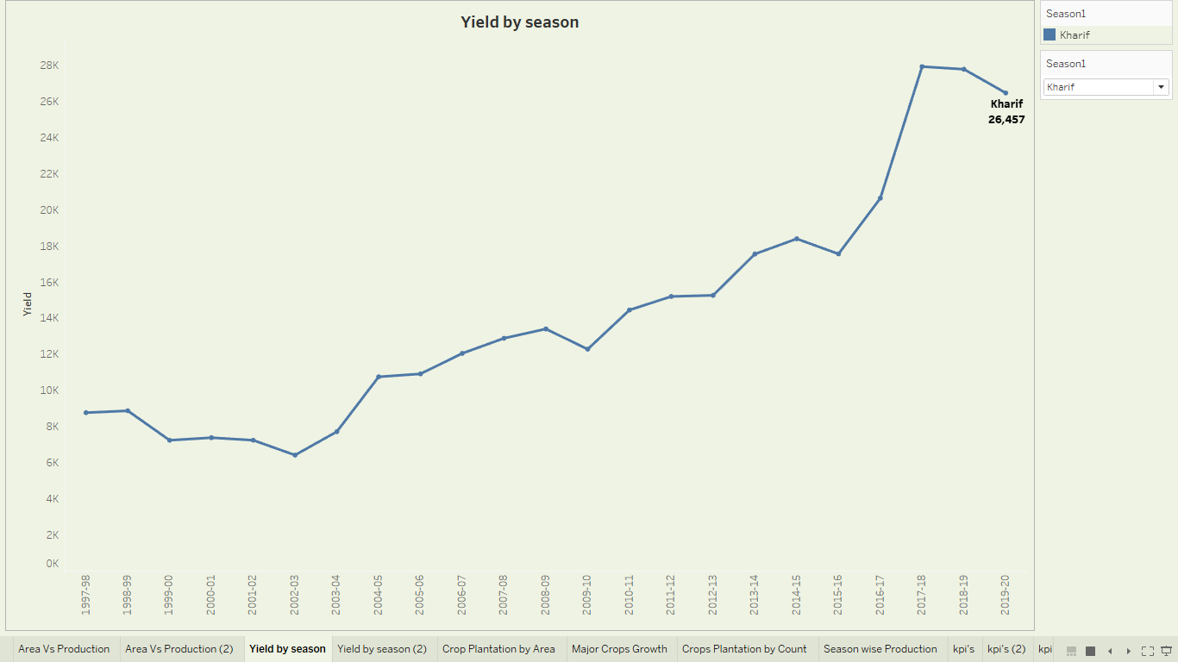

Line chart
Yield by season:
This line graph shows year wise yield of crops on different season

Slide 12
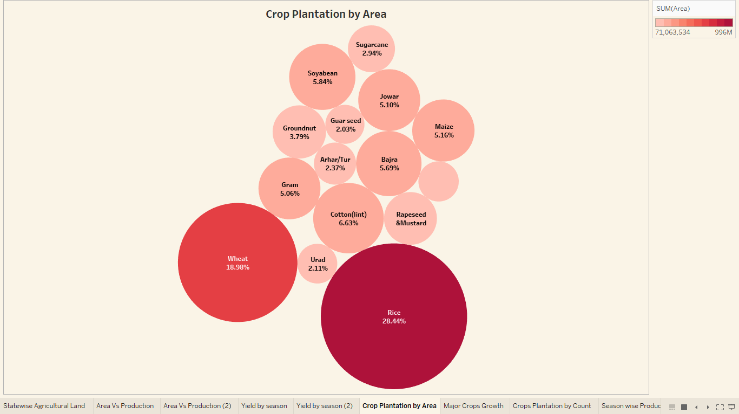
Bubble chart
Crop planting percentage:
This bubble chart shows percentage of area of cultivation of crops in India

Slide 13
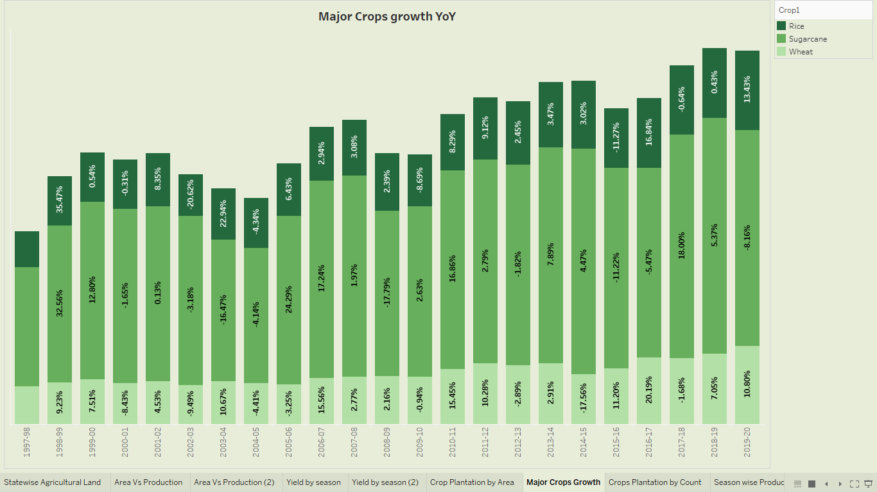
Stacked bar chart
Year-on-year percentage difference between Rice, Sugarcane, Wheat.

Slide 14
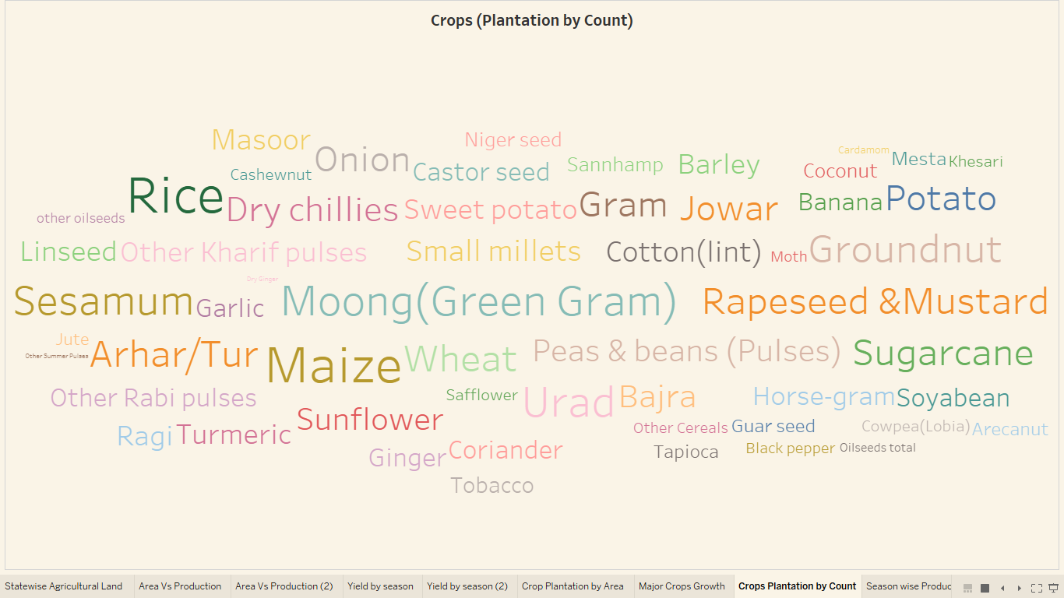
Word cloud
Word cloud:
The following word cloud gives the representation of the count of crops and the vice versa

Slide 15
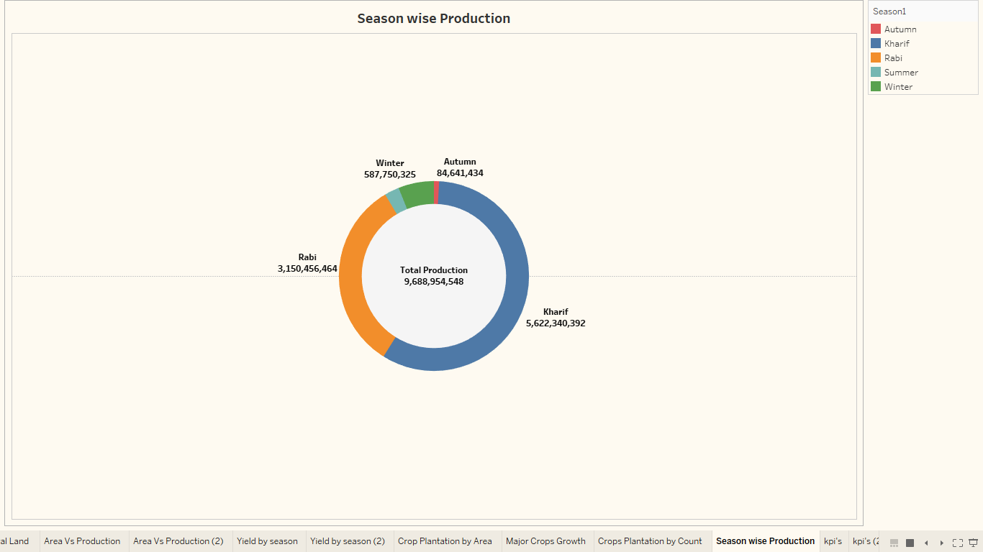
Doughnut chart
Crop production in tonnes:
This doughnut chart represents the season wise production of crops on whole year

Slide 16
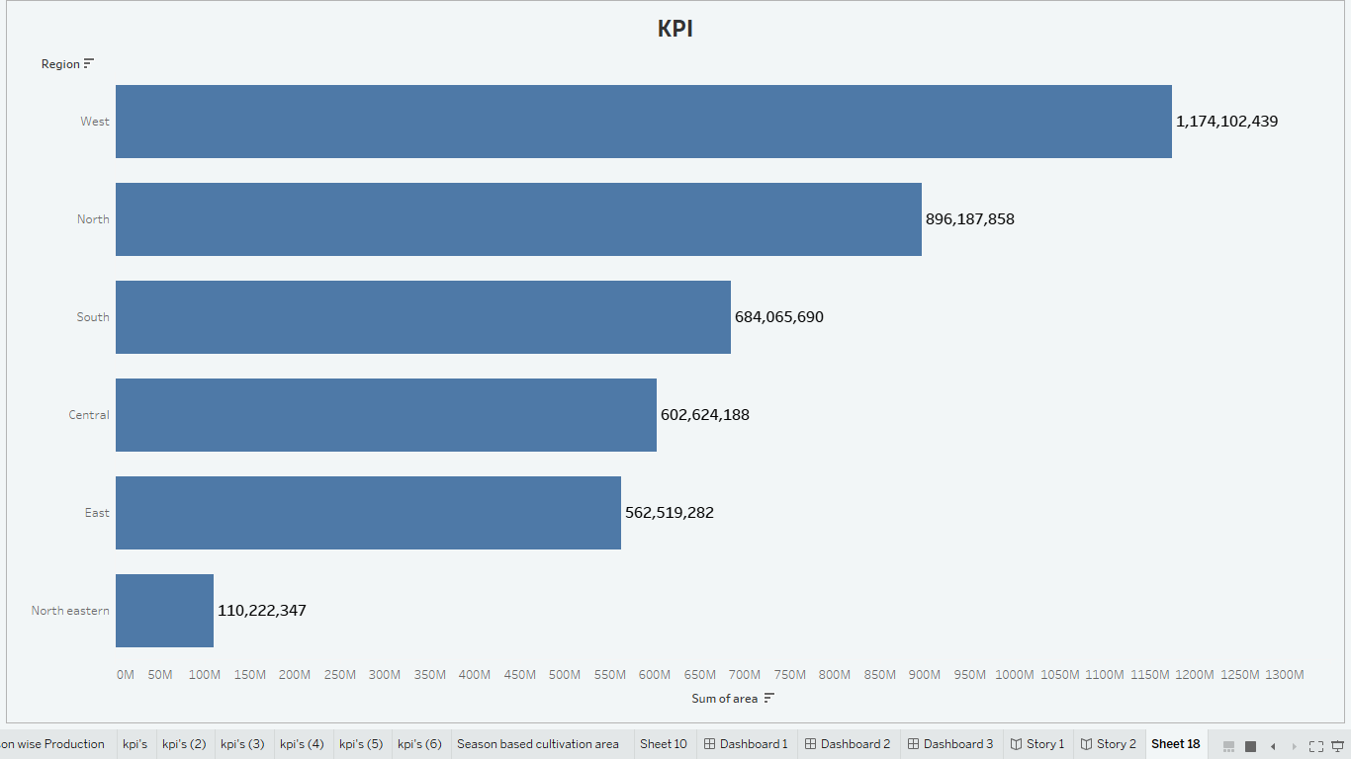
Missing data in the dataset
We have prepared the missing data of region wise area of agricultural land

Slide 17
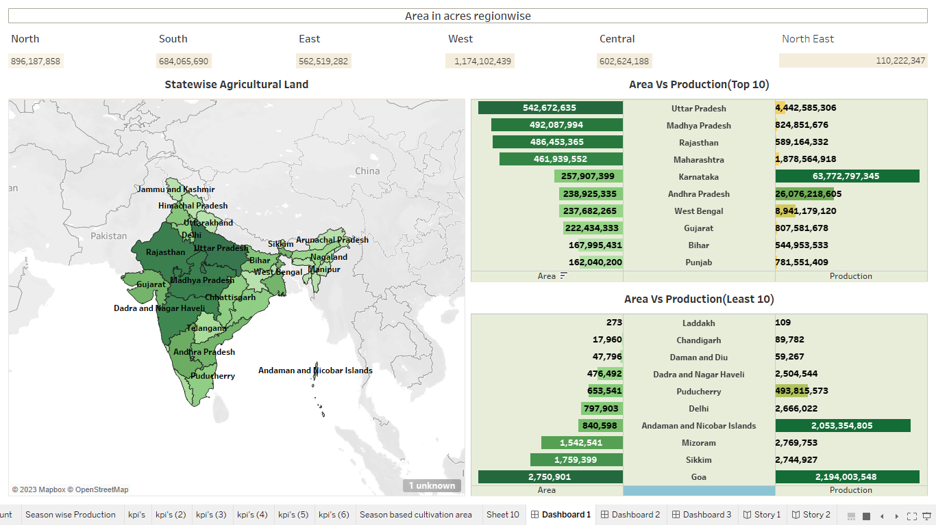
Dashboard 1
This is the dashboard which is a collection of all charts with several views at once, rather than navigate to separate worksheets
This dashboard provides production in acres of large and least area.

Slide 18
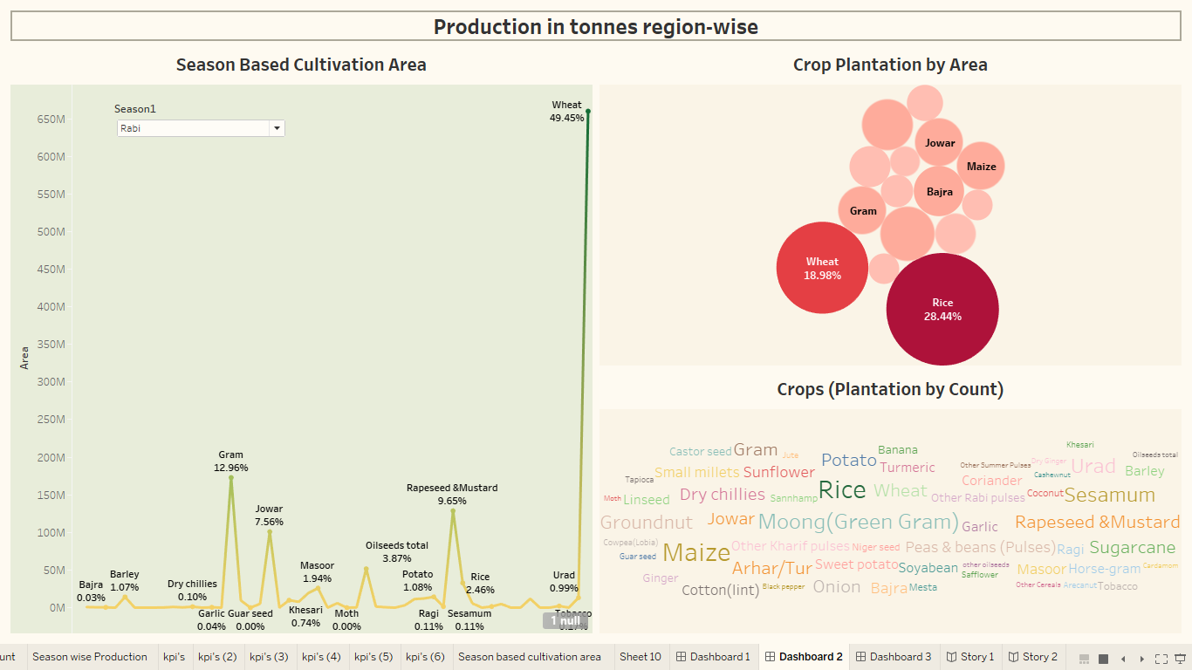
Dashboard 2
This dashboard provides data of production in tonnes region wise

Slide 19
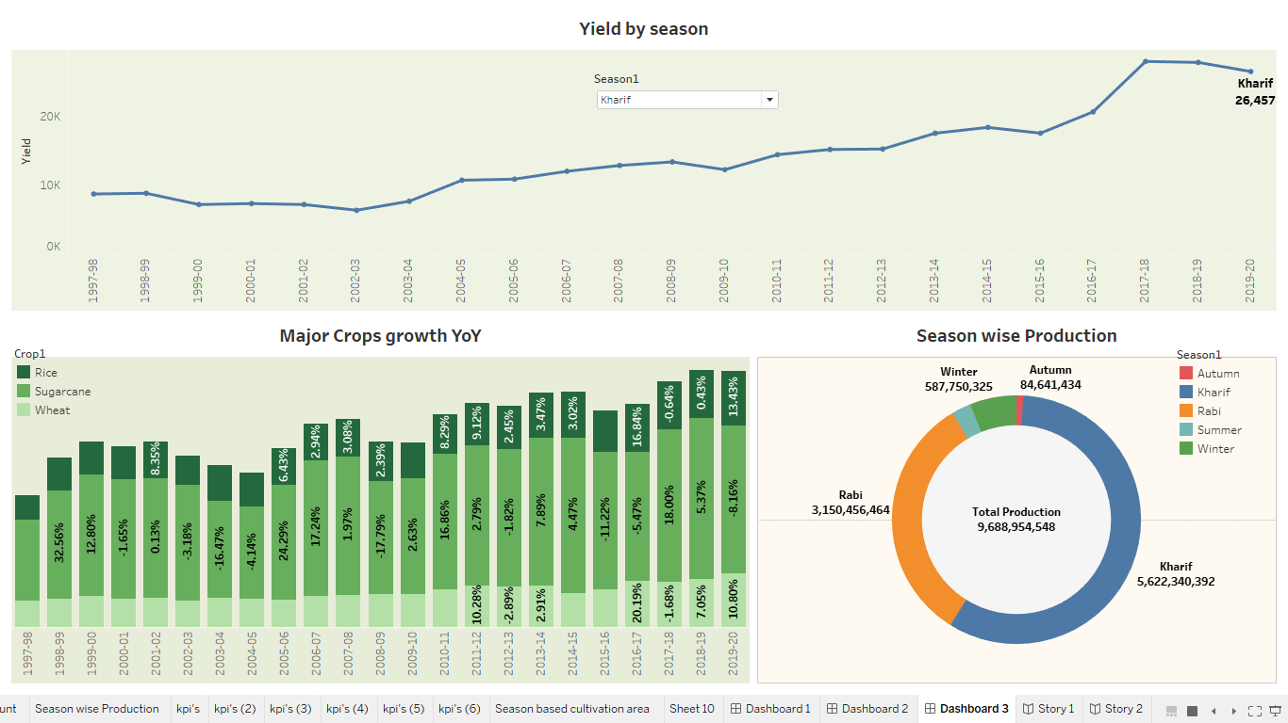
Dashboard 3

Slide 20
ADVANTAGE AND DISADVANTAGE
ADVANTAGE:
The advantage of this project is that we got the information from the given data to reduce the loss in agriculture.
DISADVANTAGE:
The region wise production, area, yield data is missing.
The data description should be provided.
Then it gives more idea about the project

Slide 21
APPLICATION:
The data given the analytics of the crop production in India.
This is very helpful for farmers to choose the better crop variety for different seasons.
This project gives the idea to decrease the loss in agriculture.

Slide 22
CONCLUSION:
The above visualizations provide the deep insight of the given data.
These information gave the idea to increase the profit and to decrease the loss on agriculture.

Slide 23
FUTURE SCOPE:
We can analyze any type of data that is provided.
Then it gives more idea about the project to work.
In future, we may try to analyze different kinds of data by using the power of tableau.

Slide 24
Thank you

